Slide 1
Integration in action
ADSS Spring Seminar, 21st March 2019
Bernadette Enright, Director of Adult Services,
Manchester City Council
Joanne Chilton,
Programme Director – ASC Transformation,
GMHSCP

Slide 2

Gmhscp: our vision
ADSS Spring Seminar: 21/03/19
overview
To deliver the greatest and fastest possible improvement to the health and wellbeing of the 2.8m people of
Greater Manchester
Notes:
‘Taking Charge’ (2016) signalled an ambitious programme to transform the operation of the health and care system in Greater Manchester, focusing on improving population health, improving outcomes, and securing clinically and financially sustainable services.
Core to this ambition was to recognise a necessary shift from uni-organisational or sectoral working to new models of integration, both in the provision of services and in the commissioning of them. GM collectively regarded this as the best opportunity to support residents be independent and well, to be in receipt of high quality and sustainable services when needed, and to significantly reduce costly and reactive demand.
Since 2017 new integrated commissioning arrangements between CCGs and local authorities have therefore been developed at the level of each of the 10 localities (Strategic Commissioning Functions (SCF)), and at a Greater Manchester level through the creation of the Joint Commissioning Board (JCB).
At an SCF level the arrangements are maturing rapidly – the 1st of April 2019 for example represents a step change in the formality, depth and breadth of many of the SCF arrangements. The work is driven by a belief that integrated commissioning arrangements are more likely to create the conditions for development of models of care predicated on people and place rather than organisation. This is a platform for a relentless focused on prevention, early intervention, and joined up working across health and care and indeed wider public and voluntary services.
At a time elsewhere in the country where CCGs are aggregating together to address challenges of administrative cost reduction, Greater Manchester is pursuing a different model through place based integration at locality and neighbourhood level. We are also creating opportunity to secure the necessary economies of scale and governance for decisions requiring a conurbation wide perspective through the JCB.
Inherent to both local and GM wide arrangements are the significant opportunities to influence and co-design the work of partners in securing population health and wellbeing gain. The work at a GM level on (for example) employment, transport, and air quality, is supplemented by important local effort in delivering public health interventions and building working relationships at the front line with key partners like GMP, housing providers, DWP, schools and others.
GM has therefore created for itself the potential to exploit economies of scale at a GM level where required, and a step change on our focus on prevention, early intervention, integrated provision, and demand reduction at a local level. There is some evidence of good progress being made.

Slide 3
Social care as part of a neighbourhood model
ADSS Spring Seminar: 21/03/19
overview
Integrated Commissioning: Pooled Health & Social Care Budget
Example Services
Reablement
Well-being teams
Care at Home
Early/Intervention Prevention Services
Supported Housing
Adult Social Care
Mental Health support
Voluntary Sector
Wider public services
Children’s Services
Community Link Workers
Community Health Services
GP Practices
Neighbourhoods
30-50k Population within LCO

Slide 4
Manchester Making integrated working a reality
Bernie Enright – Director of Adult Services
Manchester Local Care Organisation

Slide 5

Notes:
TO DISCUSS and GET FEEDBACK ON
This is a set of statements to support clarification for partners and statekholders on what the LCO is and will be.
Are the statements accurate?
Anything missing?
Anything to add?

Slide 6








Why we need to do things differently
Manchester has:
So we need to:
Significantly lower life expectancy than the rest of the country
8.2 years for men
6.4 years for women
Route our public funds to the places they can make a difference
Support prevention and self-care to help people stay independent in their own homes – and be connected to local support services and community groups
More than double the rate of alcohol specific admissions than the England average
The 2nd highest rate of early death from respiratory diseases in England – 60pc could be avoidable
Shift the focus of care away from hospitals and in to our communities
The highest number of smoking related deaths in the country
Reduce inequalities in experience, access and care across the city – simplifying the patient journey through health and social care.
Notes:
TO DISCUSS and GET FEEDBACK ON
This is a set of statements to support clarification for partners and statekholders on what the LCO is and will be.
Are the statements accurate?
Anything missing?
Anything to add?

Slide 7




Changing the Manchester system
A single commissioning system
A single hospital trust
A single community organisation
April 2017
October 2017
April 2018
MLCO is formed by a partnership agreement
Notes:
TO DISCUSS and GET FEEDBACK ON
This is a set of statements to support clarification for partners and statekholders on what the LCO is and will be.
Are the statements accurate?
Anything missing?
Anything to add?

Slide 8

Making up our LCO
Community Health
Social care
Primary care
Mental health
3,000 staff
Bringing two systems together
12 integrated neighbourhood teams
Getting local people involved
Notes:
TO DISCUSS and GET FEEDBACK ON
This is a set of statements to support clarification for partners and statekholders on what the LCO is and will be.
Are the statements accurate?
Anything missing?
Anything to add?

Slide 9

Setting our vision
Developed with staff, partners and residents, our vision is for the people of Manchester to have:
Have equal access to health and social care services
Receive safe, effective and compassionate care, closer to their homes
Live healthy, independent, fulfilling lives
Be part of dynamic, thriving and supportive
communities
Have the same opportunities and life chances -
no matter where they're born or live.

Slide 10

Our behaviours are Manchester’s behaviours
Our approach been developed from the Our Manchester principles – citywide principles and behaviours developed in partnership with stakeholders and residents across the city
Notes:
Our Manchester provides a framework for actions by partners working across Manchester – public sector organisations, businesses, the voluntary sector and our communities.
It is not a strategy for Manchester City Council, but for Manchester.
It stresses that everyone has a role to play in making our city the best it can be.

Slide 11


Slide 12

A new culture
Getting that right is the most important thing for us:
Engaging our staff from day one – they’ve designed MLCO along with service users
Cutting across boundaries – developing integrated posts open to health and social care staff for the first time, joint HR systems, OD and single appraisal processes
Engaging the VCSE sector – seconding a VCSE leader into our team and creating a memorandum of understanding
Bringing our team together – over 200 of our leaders and frontline staff at our first Freedom to Lead event
Enhancing what’s in the city, not duplicating – working with our partners to develop great engagement in the city, building on what’s already going on in neighbourhoods.

Slide 13

Put down roots – expect to work together

Slide 14
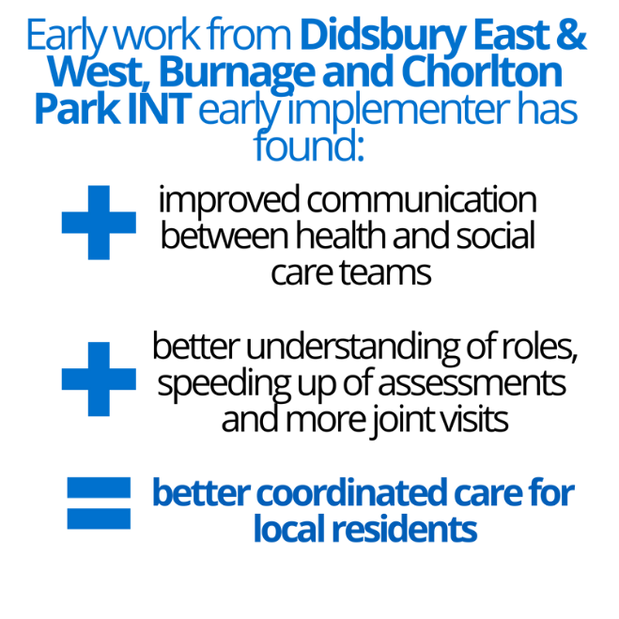
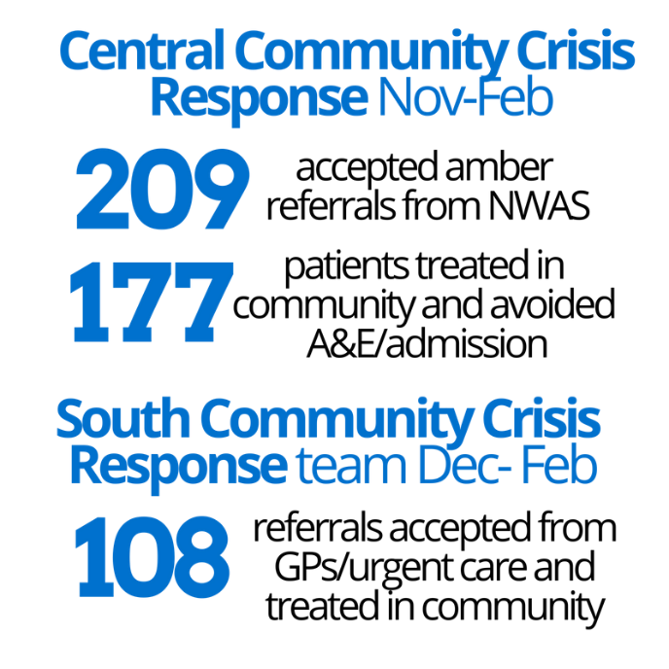
Integrated Neighbourhood Teams
Making the difference
12 teams now being established across the city
Each team has a neighbourhood ‘quintet’ team of neighbourhood team lead, GP lead, nurse lead, social care lead and mental health lead
Integrated hubs so health and social care teams are working together day to day
Manchester Community Response
Prevents patients needing to be admitted to hospital by providing highly skilled crisis care in the community
72 hours of crisis care delivered by advanced practitioners and a wider health & social care team before onward referral and support

Slide 15
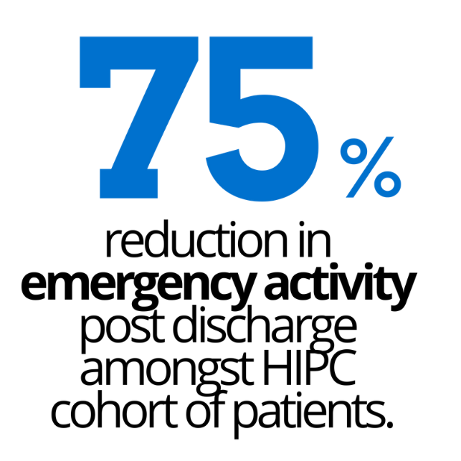
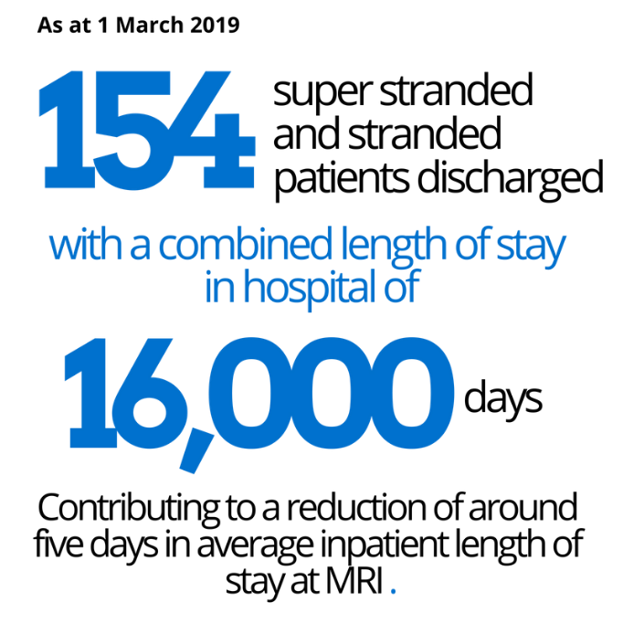
High Impact Primary Care
Making the difference
High Impact Primary Care (HIPC) pilots are in place in three neighbourhoods in the city
International best practice model of health and social care intervention with the most vulnerable 2% of the population
Led by a GP, working alongside a nurse, social worker, wellbeing adviser and pharmacist.
Supporting hospital flow
Focusing on ‘super stranded’ patients waiting for discharge from hospital for the longest time
Using our integrated role across health and social care to better coordinate discharge of these complex patients back to the community.

Slide 16


Slide 17
https://www.youtube.com/watch?v=0eVUrSLA7BQ

Slide 18
The gm adult social care transformation programme
ADSS Spring Seminar: 21/03/19

Slide 19
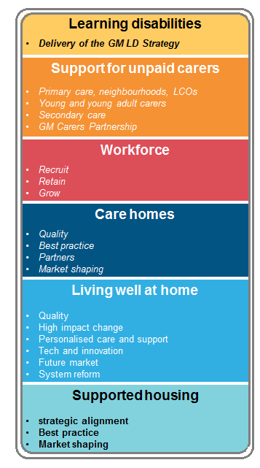

Asc transformation programme
ASC Transformation Programme Overviews
ASC TRANSFORMATION
Implement GM wide initiatives to deliver the Learning Disabilities (LD) strategy
(Jan 2020)
Enable
localities to
deliver a strategic approach to supported housing, aligned to the GM programme
(Sept 2019)
Support the implementation
of the GM Exemplar model in localities
(Sept 2019)
Top priority for each programme
Test innovative solutions to address key challenges to people living well at home
(Dec 2019)
Recruit, retain and grow a workforce ready to deliver new models of care (Mar 2020)
Develop a dynamic 5-10 year Care and Support Market Development Plan
(Mar 2020)

Slide 20
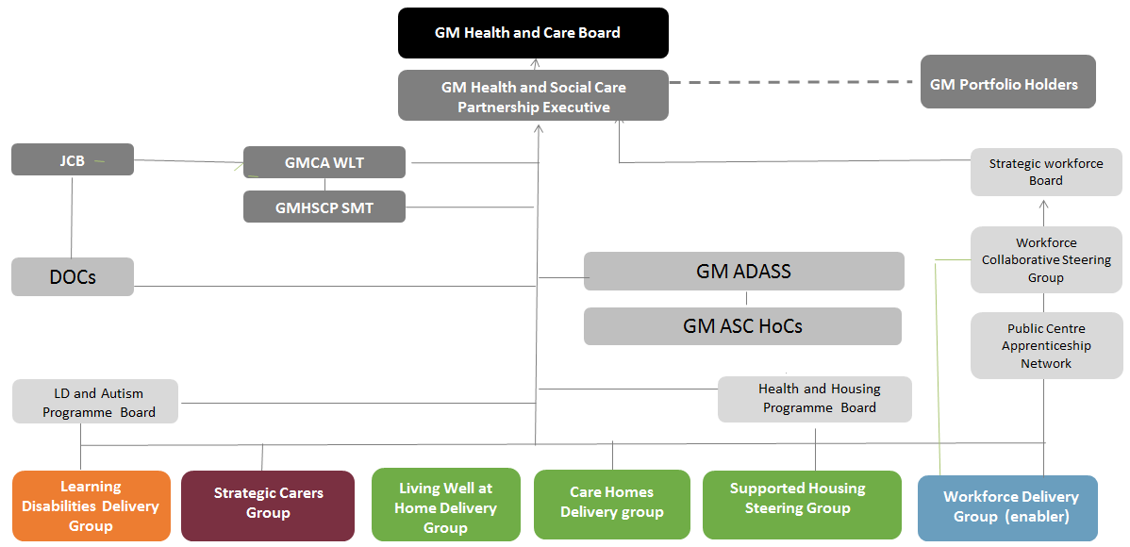
Programme governance
ADSS Spring Seminar: 21/03/19
ASC TRANSFORMATION

Slide 21
ADSS Spring Seminar: 21/03/19
ASC TRANSFORMATION
Programme Executive
Steven Pleasant
Senior Responsible Officer
 | Living Well at Home | Care homes | Learning disabilities | Autism | Support for carers | Supported housing | Workforce | ASC performance | UEC/ASC
DASS Lead | Mark Fitton | Diane Eaton | Mark Warren | Rachel Tanner | Julie Gonda | Stuart Cowley | Steph Butterworth | Julie Gonda | Diane Eaton
Deputy | Adrian Crook |  | Rachel Tanner | Mark Warren | Mark Warren |  | Bernie Enright
Executive member | Cllr Joanne Harding | Cllr Wendy Wild | Cllr Zahid Chauhan | Cllr Ann Cunliffe | Cllr Andrea Simpson | Cllr Keith Cunliffe | Cllr Bev Craig | Tbc | tbc
cc
System support
Programme Director ASC Transformation
Senior Commissioning Manager - ASC
Programme Manager
Living Well at Home/Care Homes
Programme Manager - LD
Programme Manager - support for carers
Strategic Relationship Manager (Housing)
ASC Workforce Lead
Programme
management
Senior Analyst – ASC
Project Manager Living Well at Home / Care Homes
PMO
Project Manager
Business Support Officer
21
21

Slide 22

LEARNING DISABILITIES
ADSS Spring Seminar: 21/03/19
ASC TRANSFORMATION
Employment:
Enabling more people to obtain paid employment and supporting young people to consider their employment options during transition. GM target of 7% of people with LD in employment by 2020
Bespoke commissioning:
Embedding person-centred planning approaches and new commissioning arrangements for people who need the most support
Joint
commissioning
for people with complex care needs
Nov 2019
Good health:
Reducing health inequalities by improving access
Jointly Developed Health Equality Resource
Nov 2019
Advocacy:
Supporting people and their families to speak up for themselves
GM Specialist Employment Service
Oct 2019
LD Provider / Partnership Forum
May 2019
DELIVERY
OF THE
GM LD
STRATEGY
Co-produced plans for Justice and Advocacy
Jan 2020
Upscaled Family Based Care Offer / Processes
Jul 2019
LD
Workforce
Plan
Apr 2019
Strategic Leadrship: Coproduction and leadership to reduce inequalities experienced by people with a learning disability
Justice system:
Offenders being represented, treated fairly &supported not to reoffend; ensuing victims have a voice
Housing Position Statement for Autism and LD
Oct 2019
Homes for people :
Ensuring people have a choice about where they live, which kind of housing they live in & are supported to live as independently as possible. Expanding shared lives to 15% of the LD population by 2022
Workforce:
A skilled workforce and quality providers that know how to support people and demonstrate humanity and values
Where you can find the full strategy: www.gmhsc.org.uk under ‘our plans: people and services’ Click here
Notes:
OUTCOMES:
Increase in the use of family based care in GM
Better commissioning and quality provision to support people with complex needs and those at risk of hospital admission
Improved health equalities for people with LD
Increase in number of people with LD in meaningful and sustainable employment with each locality working towards achieving / exceeding national average
Continuous improvement of quality within LD provision
A skilled workforce that knows how to support people and demonstrates humanity and values
Ensuring offenders being represented, treated fairly and supported not to reoffend and ensuring victims have a voice and accessing appropriate support

Slide 23


SUPPORT FOR CARERS
ADSS Spring Seminar: 21/03/19
ASC TRANSFORMATION
GM Standard
for Young Carers Support Services
Aug 2019
GM
Exemplar Model Implementation in Localities
Sept 2019
GM Carers Quality Mark
for GPs
Jan 2020
Delivery of the GM Carers Charter
Wider Implementation
of the Best
Practice
Working Carers
Framework
Jul 2019
GM
Carers Performance Dashboard
Nov 2019
Secondary
Care Business Case &
Options Appraisal
Aug 2019
Notes:
OUTCOMES
Carers will:
Find it easier to access care at GPs to get prevention support to keep them healthy and well
Be identified quickly as a carer and know where to go for support when needed
Be listened to as an expert in care planning
Be helped to better understand and manage the condition of their cared for person
Be able to be socially connected and feel fulfilled in their life and their life as a carer
Have care wrapped around them by a mixture of health and care professionals
Be actively involved in providing assurance on the delivery of the Carers Charter and the Exemplar model

Slide 24






ADSS Spring Seminar: 21/03/19
ASC TRANSFORMATION
Primary Care, Neighbourhoods
&
LCOs
GM Carers
Partnership
Commissioner
Young Carers & Young Adult
Carers
Secondary Care & Carers
GM Strategic Carers Group
BAU
Implementation of
Working Carers Toolkit & EfC
NHS Long Term
Plan – GP Quality
Marks (and YP
Tool Kit )
GM Exemplar
Model
Costings &
NW ADASS Stocktake
Adoption of
GM Minimum
Service
Standards
GM Support
For Carer
Programme
Must Do’s
Secondary Care
and Carer Group meeting
Implementation
Exemplar Model &
Performance
Dashboard
LCO &
Neighbourhoods
Development
Work
Carers Led
Confirm &
Challenge
Session
Funding plan for
Young Carers
Digital Portal for Best Practice
Governance redesign & BAU Locality
Assurance
National Carer
Action Plan and
NHS Long Term
Plan – inc Carers Passports
Business Case
and Options Appraisal Development
Carers as
Experts in
MDT Process
Review of
Each Localities Carer
Partnership
Boards
Delivery of
Young Carers
Objectives (inc Engagement with Schools & MH)
Engagement
with National Strategic
Partners
Communication
And Information
Programme

Slide 25

WORKFORCE
ADSS Spring Seminar: 21/03/19
ASC TRANSFORMATION
Blended
Roles in Operation
Aug 2019
GM Social Care Skills Academy
Mar 2020
GM Training/ Skills Passport and Protocol
Jul 2019
Best Practice Recruitment Framework and Toolkit
Sept 2019
Working Carer Locality Support
May 2019
GROW
Induction
Best Practice Framework and Toolkit
Sept 2019
Aspiring Registered Manager programme
Jun 2019
RECRUIT
Teaching Care Homes Workforce Development Programme
April 2019
RETAIN
Notes:
OUTCOMES
Reduction in turnover and vacancy rates in areas where products have been trialed
Improved perception of social care as a career within GM
Increased engagement of public and private sector businesses across GM to support working Carers
Increased levels of confidence and competence across ASC workforce
Ownership of ASC workforce innovations across all 10 localities

Slide 26
CARE HOMES
ADSS Spring Seminar: 21/03/19
ASC TRANSFORMATION
MARKET SHAPING
Model of Primary Care Offer into Care Homes
Jul 2019
GM Market Development 5-10 year Plan
Mar 2020
Standard Continence Grab Guides
Aug 2019
Live Bed State Capacity Tracker in all care homes
Sept 2019
GM Wide Quarterly CQC Ratings Performance Dashboard
BEST PRACTICE
Options Appraisal for Peer Review System
Sept 2019
GM Quality Kitemark
Mar 2020
NHS email system in all GM Care Homes
Jun 2019
Standard Principles & Procedures for Med Optimisation in place
Sept 2019
QUALITY
Poly Pharmacy Reviews undertaken
Mar 2020
Complete Quality Improvement Model
Apr 2019
Quality of Life / Care Exemplar Model
Sept 2019
PARTNERS
Joint training for Acute Hospital & ASC staff
Mar 2020
GM Provider Conference
Nov 2019
GMHSCP & GMICN MOU
May 2019
Notes:
OUTCOMES
Better quality of life and individual experience
Continuous improvement in quality across ASC
Excellent quality care with an improved experience and choice
A vibrant community offer
Prevent avoidable non elective admissions to acute hospitals and DTOC
Sufficiently flexible and adaptable commissioning model

Slide 27
ADSS Spring Seminar: 21/03/19
ASC TRANSFORMATION
Further stock take against the High Impact, and `Enhanced Health in Care Homes’ Models
July 2019
Dynamic Market development plan based on Predictive Modelling and Engagement with Independent Providers
Mar 2020
Roll out a GM Quality of Life and Care Model, with emphasis on `what matters to you’ & vibrant community offer
Sept 2019
CARE HOMES
Delivery
Board
Priorities
Evidence of new technology used to improve provision & systems
Oct 2019
Develop Teaching Care Homes and Links to Research and Evaluation
June 2019
Quality in Care Homes.
Develop Options for Peer Review & other User Led Quality Systems including Healthwatch
Aug 2019

Slide 28

LIVING WELL AT HOME
ADSS Spring Seminar: 21/03/19
ASC TRANSFORMATION
LIVINGNEEDS
QUALITY
PERSONALISED CARE & SUPPORT
FUTURE MARKET
HIGH IMPACT CHANGE MODELS
TECH & INNOVATION
SYSTEM REFORM
Quality Improvement
Model
Apr 2019
Registered
Manager Networks
(CH and HC)
May 2019
GM Market Development
5-10 year Plan
Mar 2020
New
Business Model
for Social Care
Mar 2020
New
technology in care
at home setting
Sept 2020
New Commissioning
& Contracting
Model
Mar 2020
Quality of
Life / Care Exemplar Model
Sept 2019
Development Programme for Care at Home
May 2019
Pathway and Process re Nutrition & Hydration
Sept 2019
Personalised
Care Support Journey
Aug 2019
GM Quality Kitemark
Mar 2020
Roll-out
Registered
Manager
Programme
May 2019
Notes:
OUTCOMES
Excellence in care and support, and genuine quality of life and experience, based on what matter to people individually
People involved in planning their own personalised and community based support
Recognise communities and individuals strengths and resourcefulness
Less avoidable, non-elective attendance and admissions to acute hospitals
Less falls and avoidable harm
Recognise and utilise individuals and communities strengths and resourcefulness
APPRECIATIVE ENQUIRY We met with commissioners and other partners in all localities to discuss what’s working well, what we can build on and how we can work effectively and creatively to develop and shape a new model of Living Well at Home. This enabled us, to communicate, share and debate the vision and ambitions of the LWAH and use feedback to broaden and enhance the model, for example putting greater emphasis now on market shaping, wider public health/community engagement, & specifically focusing on seeking alternatives to the traditional time and task system.
ACTING ON CITIZENS INQUIRY RECOMMENDATIONS We have agreed some joint plans with the Citizens Jury which undertook the Independent inquiry into Care at Home in Greater Manchester last year. We are planning two joint events to follow up on these recommendations and ensure we engage with the people who took part.
BROADENING PROGRAMME TO ENSURE A WHOLE SYSTEM APPROACH We have held established partnership links beyond the Delivery Group co-ordinate the different elements of the LWAH programme and understanding links and dependencies. This has helped create strong links to other parts of the GMHSCP, including the Urgent Care programme, Person Centred & Community approaches, Public Health initiatives, Workforce, and Dementia United, & these additional proposals are feeding back into the LWAH Delivery Group to inform the Trailblazers

Slide 29
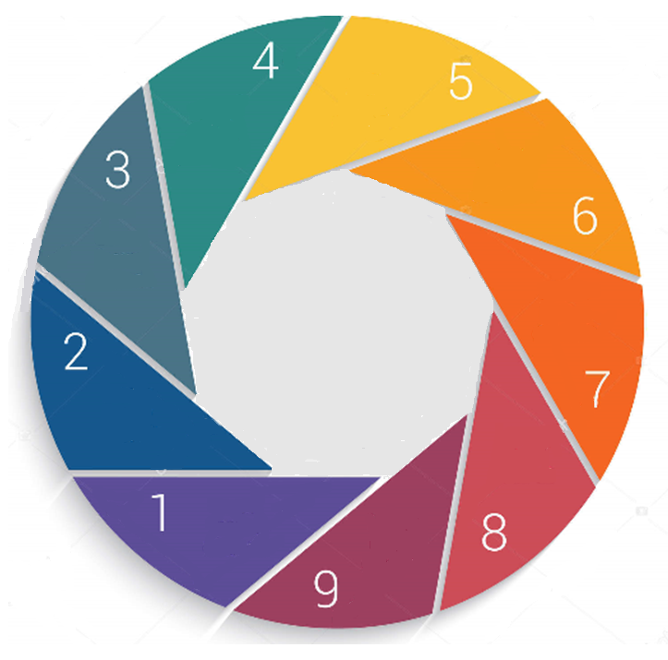

trailblazers
ADSS Spring Seminar: 21/03/19
ASC TRANSFORMATION
Prevention /
admission
avoidance (frailty)
(Teresa Emery)
An accelerated improvement approach to address some key challenges aligned to the LWAH themes
Social care cooperative
model
(Vince
Fraga)
System
reform & moving away from time/task
(Mark Rotheram,
Zoe Porter)
Blended
roles
(Jo Finnerty)
Each trailblazer will develop, test and
implement change on a neighbourhood footprint.
Understand the problem – how are things now
Test and improve – what should we prioritise doing differently
Sustain and Build – Measure, reflect, learn, make it stick
Living Well
at Home
Trailblazers
Technology
& innovaton
(Tim Bryant)
Nutrition &
hydration (linked
to public health)
(Janine Dyson)
Public
health
& broader
determinants
of health
enabler
(scope tbc)
Personalised care
& support
(Gill Bailey)
Data &
predictive
modelling
enabler
(Liz
Goodger)

Slide 30

SUPPORTED HOUSING
ADSS Spring Seminar: 21/03/19
ASC TRANSFORMATION
Locality Supported Housing Strategies
May 2019
Support to
Localities
Plan in place
April 2019
Locality Supported Housing Pipeline
April 2019
LGA Extra Care Resource Pack
May 2019
MARKET SHAPING
LGA Support Workshops with DASSs / SH Steering Group
Jun 2019
Extra Care Prospectus
April 2019
STRATEGIC ALIGNMENT
Predictive Modelling of LD/MH Housing Need
April 2019
BEST PRACTICE
Notes:
OUTCOMES
Clear pipeline of supported housing development across all client groups in localities, linked to strategic objectives
Examples of partnership working and best practice sharing around supported housing
Better understanding of the quality of current supported housing stock in GM and whether it is fit for purpose
Evidence of market shaping through engagement with supported housing strategies / prospectuses

Slide 31
OUTCOMES
ADSS Spring Seminar: 21/03/19
ASC TRANSFORMATION
Living well at home
New quality assurance framework being written in partnership with the sector
Improvement of CQC quality ratings - improving faster than national and regional comparators. 3 of the top 6 most improved LA’s nationally
Co-production of a quality of life framework encompassing `We’ statements and the wider determinants of health, development of a quality statement as it encompasses quality life, care and system partnership
PQUIP model embedded within with GM Quality Framework
Continued roll out of Enhanced Health in Care Homes
Red Bag transfer scheme now in place across GM
Most homes now have a local GP practice that serves the home as part of the neighbourhood model
Roll out of Nursing and Residential Triage Tool
Development of a GM approach to Teaching Care Homes
Buddying system and clinical supervision programme for RMs
Person Centred Community Approaches in care homes and care at home through a RM network
Tech – NHS mail, capacity trackers, electronic QA tool (PAMMS)
Meds optimisation in care homes
Greater Manchester Trusted Assessor Support network
Establishment of the GM Independent Care Sector Network (Board, website over 150 member organisations, two large conferences)

Slide 32
Cqc ratings
ADSS Spring Seminar: 21/03/19
ASC TRANSFORMATION
Percentage of care homes in GM with a current rating of good or outstanding:
Percentage of domiciliary care agencies in GM with a current rating of good or outstanding:
The figures are represented as a percentage of homes and domiciliary care agencies which have been inspected under the current CQC regime and have been received a rating. For the avoidance of doubt, those services which have ‘no published rating’ are not included in this analysis

Slide 33
ADSS Spring Seminar: 21/03/19
ASC TRANSFORMATION
Learning disabilities
GM LD Strategy, coproduced with self advocates and their families
GM Autism Strategy also co-produced and developed by GMAC, priorities align with LD Strategy
Upscaling of shared lives and increased investment across GM
Supported employment investment, locality targets, best practice standards
Developing of the GM Specialist Employment Service
Increase in people in employment
PCCA innovation project testing new approaches for people with complex needs including those in transition
GM Flexible Purchasing system – only providers with rating of ‘good’ or above on framework.
Tackling health inequalities by increasing the number of people registered with a GP and accessing Annual Health Checks
Supported housing
GM Supported Housing census, shop@ and north west market oversight review has led to publication of supported housing commissioning support evidence packs to support locality strategic commissioning
Supported housing need and evidence base included within GM planning and estates strategies
Locality supported housing strategies by the end of March 19
Launch of Extra Care CBA tool for localities
Predictive modelling of accommodation needs for older people, learning disabilities, physical disabilities and mental health needs

Slide 34
ADSS Spring Seminar: 21/03/19
ASC TRANSFORMATION
Workforce
Registered Manager Leadership Development programme
RMs best practice network
Framework for aspiring Registered Managers
Establishing minimum training /skills standard for care homes across GM
Training Passport to allow portability of training to agreed standards, across the social care sector
Development of a pre-apprenticeship programme for entry-level care roles
Facilitation of roll-out of use of NHSP to cover shortages in care homes, across GM
Development of Neighbourhood based blended roles, together with an underpinning skills development programme, based on an identified good practice care at home model
Roll out of a best-practice values based recruitment model across care homes and living well at home, supported by induction standards and recommendations for a buddying / mentoring programme
Support for unpaid carers
GM Carers Charter and commitment to carers launched
GM Carers Partnership is enabling the voice of carers to be heard with their views reflected in decision making
Ambition for Ageing’s Working Potential programme; encouraging more older carers into employment
Exemplar model for carers support developed
Working Carers best practice model and toolkit for employers launched

Slide 35
Thank you
^{Contact us}
^{Bernie Enright}
^{Dirctor of Adult Services}
^{Manchester City Council}
Bernadette.enright@manchester.gov.uk
^{www.manchester.gov.uk}
@manchestercitycouncil
^{Joanne Chilton}
^{Programme Director -} Adult Social Care Transformation
Greater Manchester Health and Social Care Partnership
^{Joanne.chilton2@nhs.net}
^{www.gmhsc.org.uk}
^{@GM_HSC}

